Slide 1
Predicting movie revenue
Team Member: Annie Wu, Karenetta Sullivan, Xinlei Bai

Slide 2

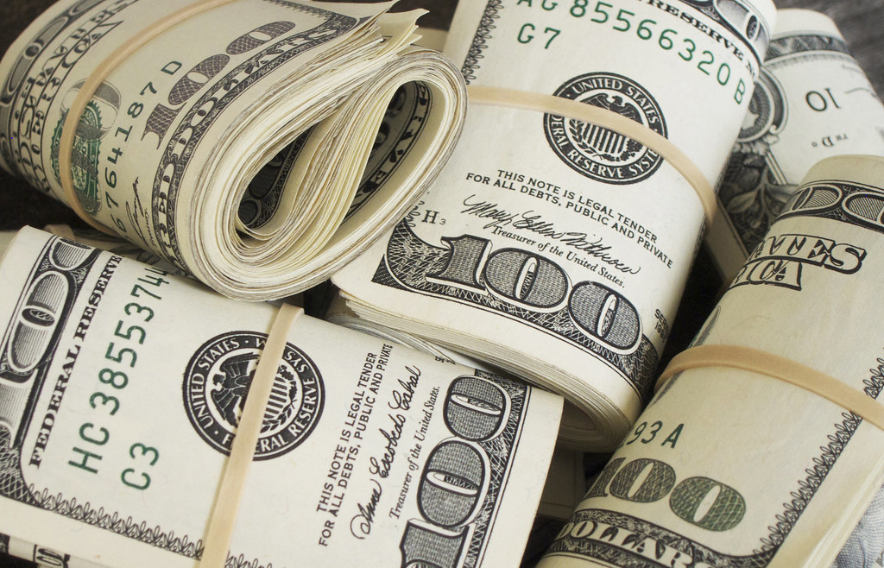
Does a good movie make good money?
Notes:
This slide talks about the background of this project and why we want to explore this question in this project

Slide 3
In this study, we attempt to use TMDb data to predict the gross revenue of the movies
Notes:
This slide talks about the purpose of this study

Slide 4
The structure of Data ANALYSIS
TMDb
Data Source
Type | Features
Nominal | Genres, keywords, original title, overview, production_companies/countries, spoken_language, tagline, status
Numerical | Budget, id, popularity, release_date, runtime, vote_average, vote_count
Data Preprocessing
Data exploration
Feature Selector
Test Data
Liner Regression Model
Output
Notes:
We need to talk about Data challenge in this slide

Slide 5


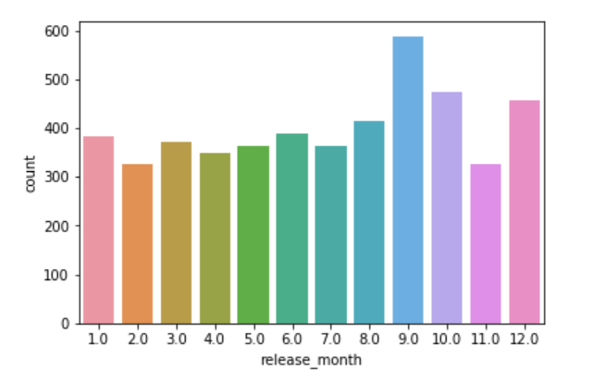
September is the “Peak month” for movie releases
Notes:
Curiosity – general understanding – movie release trends
Interesting to know
Movies always come from the summer time.

Slide 6
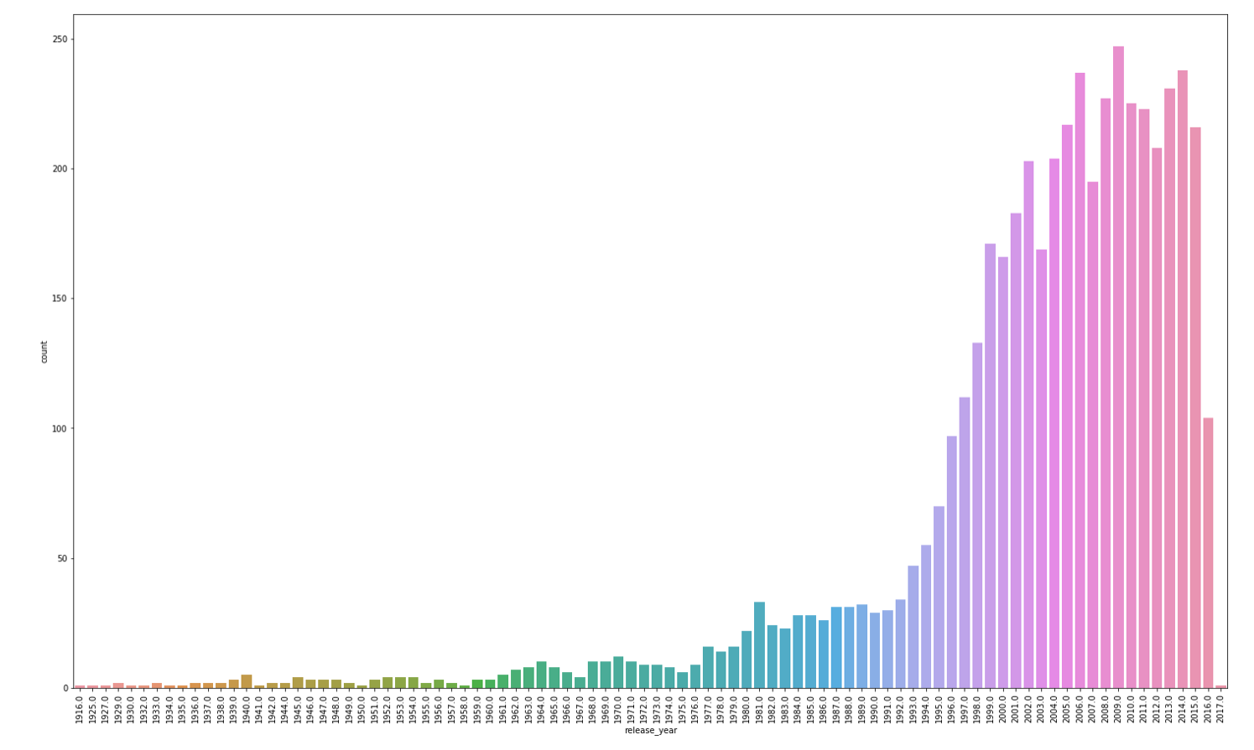
The number of movies released has been increasing since 1996

Slide 7
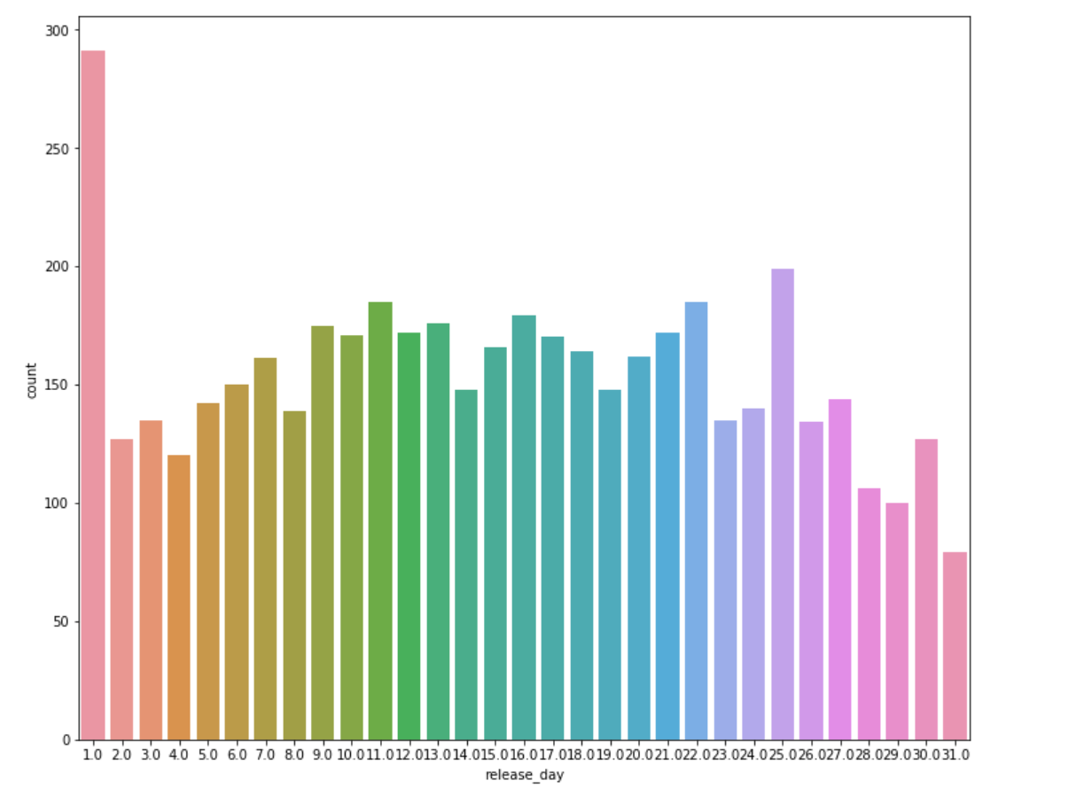
First day released movie most

Slide 8

It’s hard to say if there is a clear correlation between revenue and other variables
Notes:
And then I want to show you some charts on the relationship between revenue and other variables considered BEFORE we run modeling
The Tableau link is in the chart
https://public.tableau.com/profile/xinlei.bai#!/vizhome/Moviedata_15640155004660/Dashboard1?publish=yes
Question mark link to tableau
Back to our analytsis, But we want to see the
What is the top movie
It’s hard to say
https://public.tableau.com/profile/annie.wu7400#!/vizhome/RelationshipbetweenRevenueandNumericalVariables/Budget

Slide 9
Here we look for a correlation between all the different features under consideration and look for a model to predict movie revenue

Slide 10
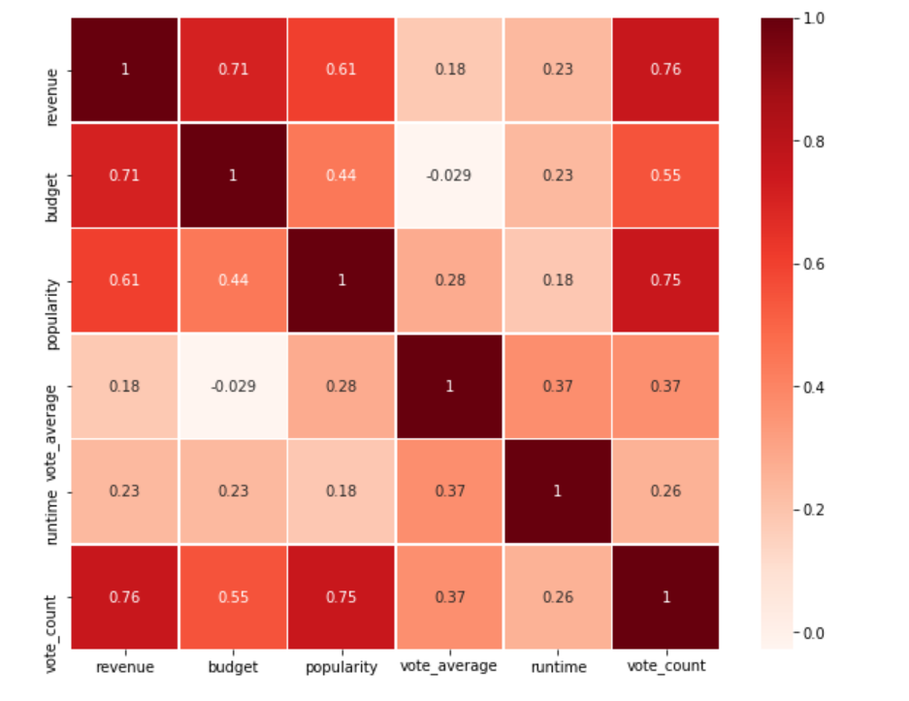
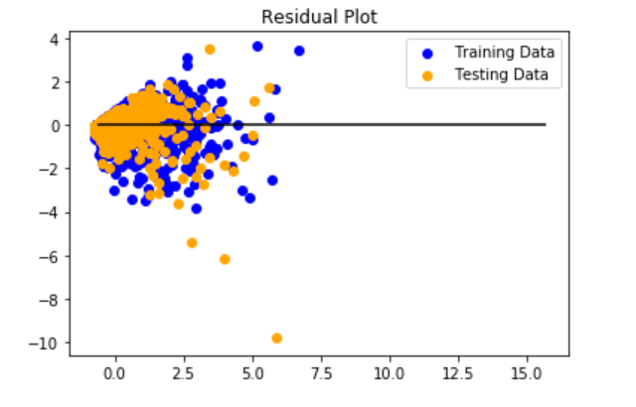
MSE: 0.508861412256261,
R2: 0.6866631462127271

Slide 11
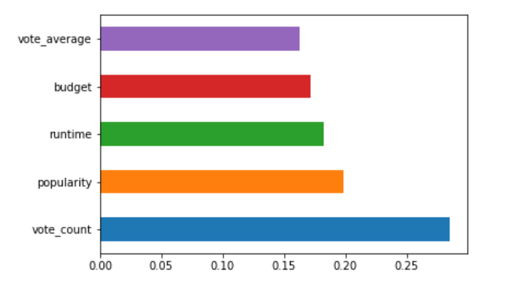
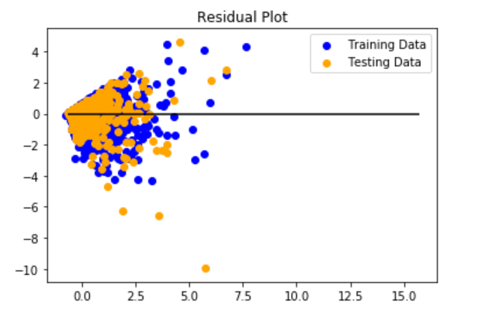
MSE: 0.6989625794433452,
R2: 0.5696063205367958

Slide 12
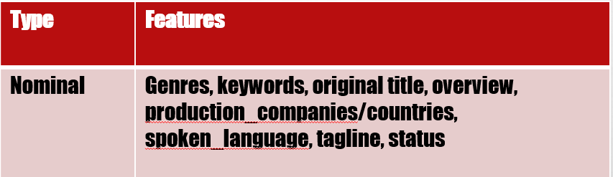
If more time … …
Notes:
We need to talk about Data challenge in this slide

Slide 13
Thank You

